Slide 1

Airline Passengers
Satisfaction Analysis

Slide 2

Overview
Airline passenger satisfaction is a critical measure of how well an airline meets or exceeds its customer’s expectations. It directly impacts customer loyalty, repeat business, and the overall reputation of the airline. Several factors contribute to a passenger's overall experience and satisfaction during their journey.

Slide 3
Importance of Airline Passenger Satisfaction Analysis
Analyzing airline passenger satisfaction is crucial for several reasons that directly impact the success and competitiveness of an airline. The insights gained from this analysis help airlines improve services, enhance customer loyalty, and maintain a competitive edge in the industry.

Slide 4
Business question
Which percentage of airline passengers are satisfied? Does it vary by customer type? What about type of travel?
What is the customer profile for a repeating airline passenger?
Does flight distance affect customer preferences or flight patterns?
Which factors contribute to customer satisfaction the most? What about dissatisfaction?

Slide 5
About the Dataset
The dataset comprises customer satisfaction ratings provided by over 120,000 airline passengers. It also includes supplementary details about each passenger's flight, type of travel, and assessments of various factors such as cleanliness, comfort, service, and overall experience.
Data Source:https://mavenanalytics.io/data-playground?page=8&pageSize=5

Slide 6
ETL and Data Modeling
I loaded a dataset containing over 120,000 ratings given by airline passengers and assessed various factors linked to passenger satisfaction such as class, customer type, travel type, food and drink options, onboard service, gender, cleanliness, check-in service, and seat comfort. To prepare the data for analysis, I used Power Query to clean and eliminate unnecessary columns. This streamlined the dataset and made it more manageable for analysis in Power BI.

Slide 7
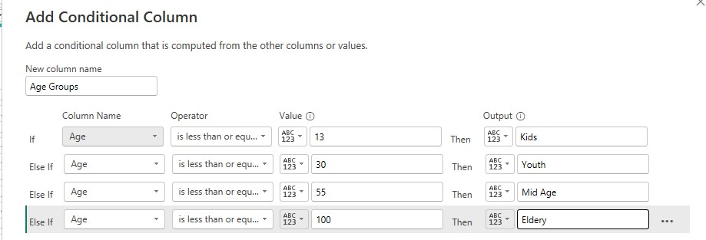
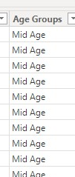
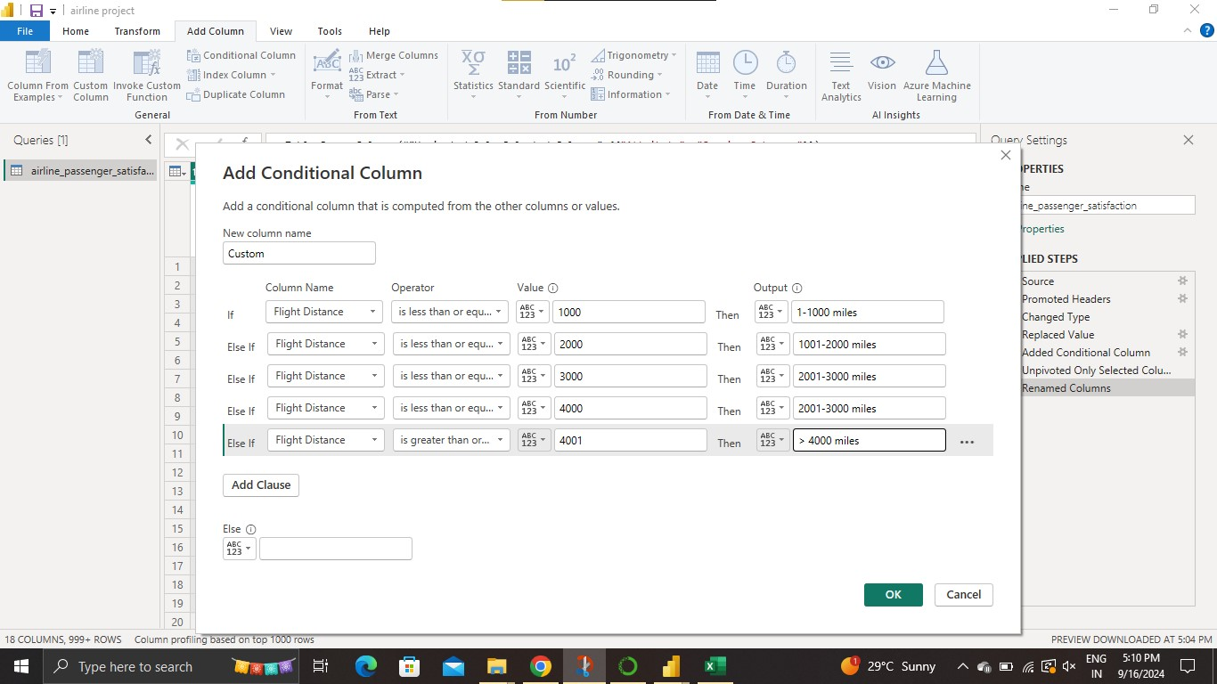
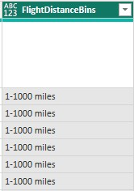
Customizations
TO
Creating conditional column using power query in powerbi
To make bins of age groups and flight distance.
TO

Slide 8
Insights

Slide 9
Satisfaction Rate
Total Passengers
129,880
Among a total of 129,880 passengers, only 44% expressed satisfaction with the airline's services

Slide 10
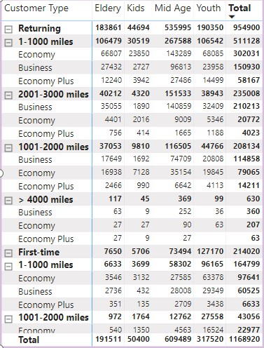
Returning Business Travelers
Returning customers are commonly middle-aged individuals (aged 40-59) who take medium-long flights (ranging from 1 to 3000 miles) for business purposes and prefer to travel in business class. This group of passengers has an overall satisfaction score of 71%, although there is room for improvement in the airline's in-flight Wi-Fi service, online booking and gate location.

Slide 11
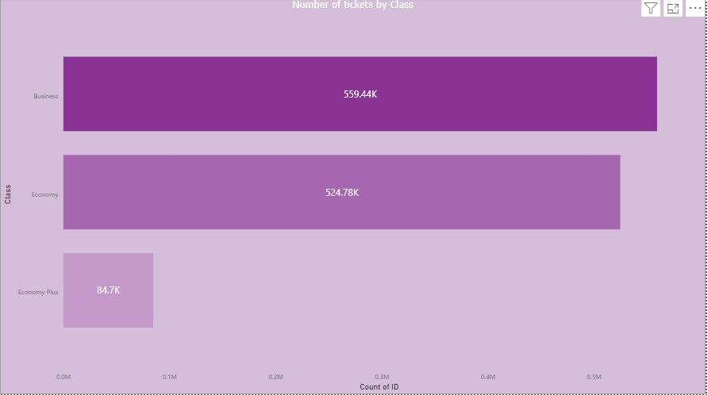
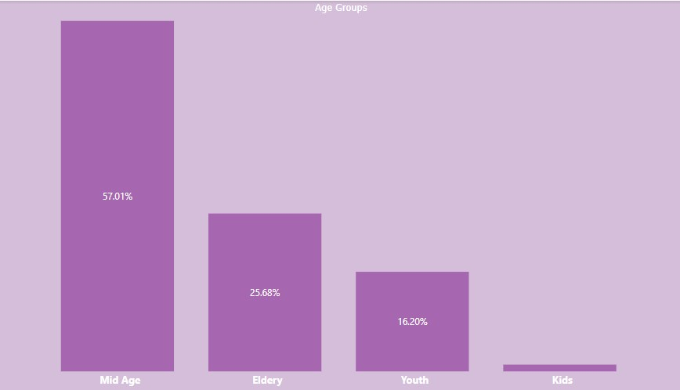
Satisfied Travelers
There are 56.55% of passengers that satisfied with the airline. Most of the satisfied passengers are from the business class, middle age group (31-55 years) with a business type of travel.
Same customer profile as above also a repeating airline passenger.

Slide 12
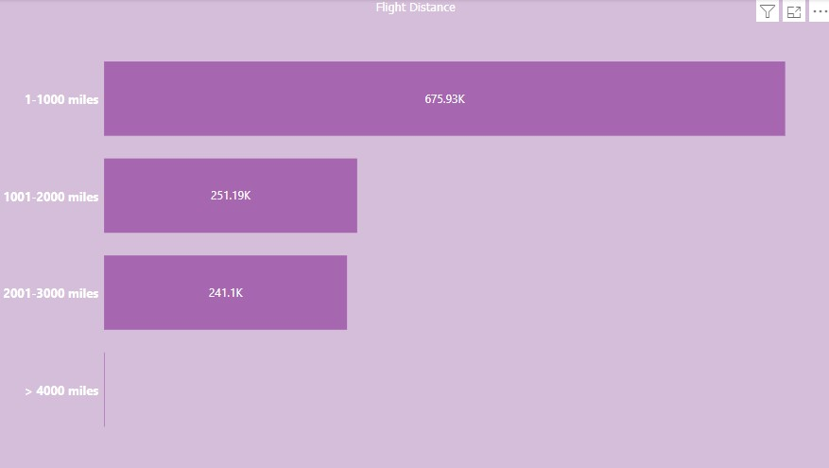
Flight Distance and Class Preferences**
Flight distance shows customer preferences: Customers with short flights usually choose economic class, and Customers with long flight distances usually choose business class.

Slide 13
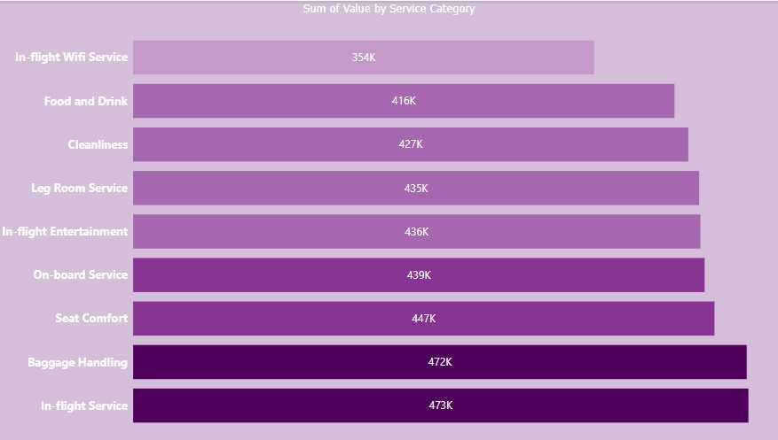
Five factors that contribute to customer satisfaction:
Online boarding
In-flight service
Baggage handling
Seat comfort
In-flight Entertainment

Slide 14
Five factors that contribute to customer dissatisfaction:
In-flight service
Baggage handling
Departure and arrival time convenience
Check-in service
Seat comfort

Slide 15

Analysis
Most customer in business class has a high satisfaction rate.
Most customer in economy class has a high dissatisfaction rate.
Only 43% of customers expressed overall satisfaction while 57% were dissatisfied or neutral with the services rendered. This satisfaction varies with customer type and type of travel.
First time passengers(76%) were more dissatisfied than returning passengers(52%).
While 90% of those who travelled for personal reasons were dissatisfied, 58% of passengers who travelled for business were satisfied with the services rendered.
The average distance for business travel is over 500km more than personal travel. This could imply that customers who travelled longer distances were given better treatment to have expressed such level of satisfaction.
Out the 14 factors that were used to assess customer satisfaction, baggage handling and in-flight services scored above average. Every other factor was just average.

Slide 16

Recommendations
If such level of first-time passengers expressed dissatisfaction, it means that only a few may return. Similarly, returning passengers may just be on the look out for an alternative.
Since those who travel for personal reasons outnumbers their business travel counterparts it's only reasonable to give them the satisfaction that they require. However, more strategies should be deployed in keeping business travelers.
Overall, stakeholders need to look at critical areas that contribute to customer satisfaction as only two factors out of 14 scored above average.

Slide 17
Thank You

